Slide 1
Mid Term Presentation
Uplift Model For Customer
Propensity Modeling
by
Sai Raghu Teja Davuluri
170907024
Under the guidance of
Internal Guide External Guide
Dr. Goutham Simha GD Mr. Aakash Sharma
Assistant Professor Sr. Manager
Department of ECE AS Dept
Manipal Institute of Technology Ugam Solutions Pvt. Ltd.

Slide 2
Contents
About the company
Problem Statement
Introduction
Software Requirements
Implementation
Data Summary
Methodology
Results
Conclusion

Slide 3
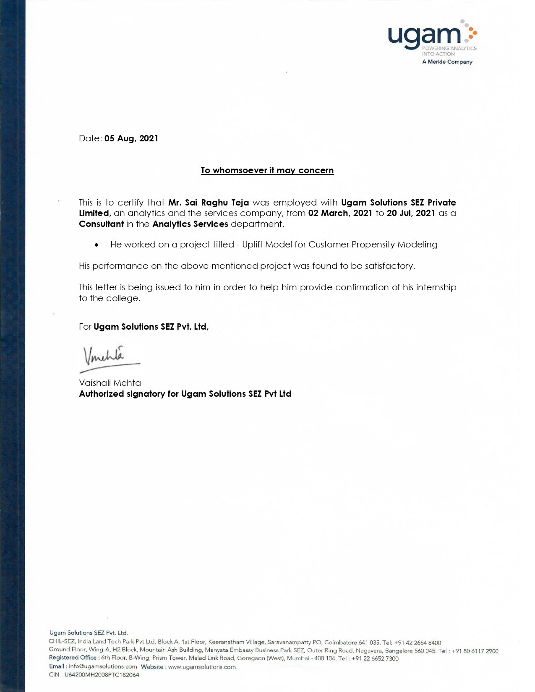
About the Company
Ugam Solutions Pvt. Ltd.
Ugam is a leading analytics and technology services company.
Over the past 20 years, Ugam has been recognized by several firms including Forrester and Gartner and was recently named the No.1 data science company in India by Analytics Insight.

Slide 4
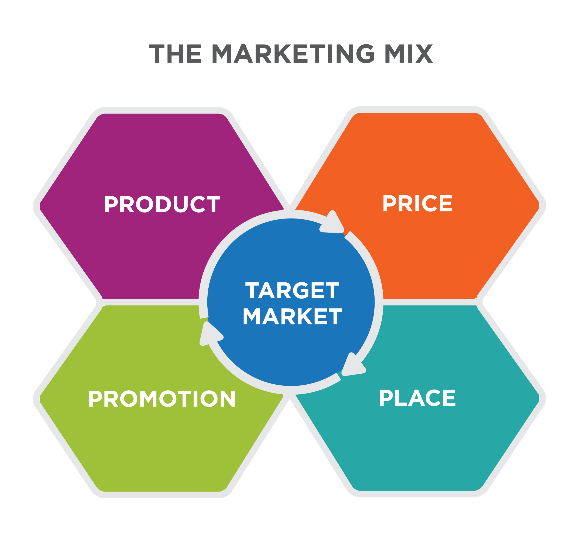
Insight

Slide 5
Problem Statement
Develop a predictive model to identify the individuals who are only likely to respond after receiving a particular ‘treatment’ you decided to give them using Uplift.
Know
Prepare
Prepare market response models.
Create
Create a model to identify the individuals who are only likely to respond after receiving a particular ‘treatment’ you decided to give them.
Know your metrics & segregate the customers according to that.

Slide 6
Introduction
Uplift modeling uses a randomized scientific control to not only measure the effectiveness of a marketing action but also to build a predictive model that predicts the incremental response to the marketing action
This project deals with knowing the metrics on which the customers will be segmented and predictions

Slide 7
Software Requirements
Language: Python 3.6
IDE: Jupyter Notebook
Libraries to be used: pandas, numpy, pylift, matplotlib, sklearn, seaborn

Slide 8
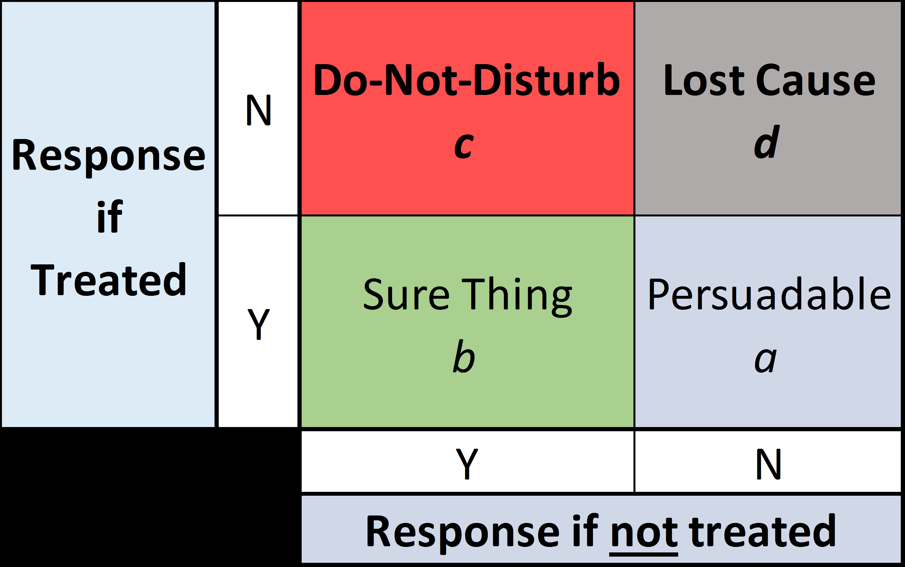
Implementation
Data is divided into two sets Control group and Treatment group
The objective of Uplift modeling is to identify the Persuadables and target them in promotion.

Slide 9
Data Summary
The data for this uplift algorithm project was gathered from a well-known insurance firm with all its physical and cloud data along with some of the features of credit companies.
We have taken a total 10,000 observations from a data source of 50M which has a significance greater than 0.5 as the train data. And a random of 2,500 observations as test data as to make a train-test ratio of 80:20.
19 variables of mixed datatypes
11 categorical variables and 8 continuous variables

Slide 10
Data Summary
treatment | HO= Control Group Promo = Test Group
zip5 | zip code
unique_key | unique identifier of the record
age | age of the customer
channel | DM = Direct Mail DM_EM= Direct Mail & Email
state | state
inq_month | months since the last inquiry was made by customer
resp | did the customer respond
conv | did the customer convert
region | region
division | division
cancel_reason_bucket | Policy cancelation reason
annual_premium_select | annual premium on the policy
driver_cnt_select | driver count in a household
vehicle_cnt_select | vehicle count in a household
polk_flag | presence of auto in a household
pif_own_rent_cd | O - homeowner R- Renter T - Refused information blank - no information available
internet_sale_ind | Policy purchased through Internet
pif_risk_lvl | risk level of customer B - preferred C - Non Preferred D - Reject
 | Blank - N/A

Slide 11
Data Summary
Target-Churn Analysis: Target or churn analysis analyzes the outcome or target variable concerning the other features among the data and the univariate analysis of the feature itself. In the data, the target variable is binary and consists of 7999 1's and 2001 0's, making it 20% of responses from the data, which is more than an industry standard to go for modelling.

Slide 12
Methodology
Understanding all the metrics in the dataset provided by the client
Pre-processing
Filtering/Imputing out the invalid entries
Label Encoding
Develop multiple models based on the algorithm
Predict probability of the output and divide them into quantiles
Assess and compare performance of models with AUC ,Recall , Accuracy

Slide 13
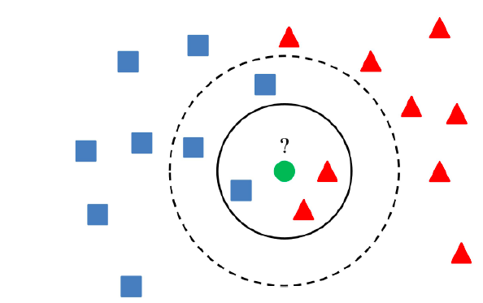
Methodology
Data Pre-processing :
a)Missing Value Treatment:
imputer = KNNImputer (n_neighbors= 5)
imputed_X_train = pd. DataFrame(imputer.fit_transform(data_X_train))
col_name | null values | After Imputation
zip5 | 0 | 0
unique_key | 0 | 0
age | 3041 | 0
channel_cd | 0 | 0
state | 0 | 0
cancels_month | 0 | 0
treatment | 0 | 0
resp | 0 | 0
conv | 0 | 0
region | 0 | 0
division | 0 | 0
cancel_reason_bucket | 0 | 0
annual_premium_select | 419 | 0
driver_cnt_select | 419 | 0
vehicle_cnt_select | 419 | 0
polk_flag | 0 | 0
pif_own_rent_cd | 600 | 0
internet_sale_ind | 465 | 0
pif_risk_lvl | 465 | 0

Slide 14
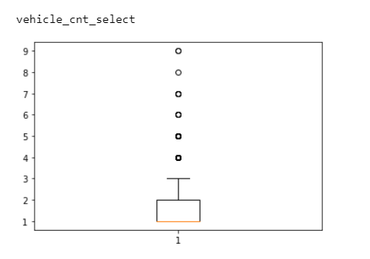
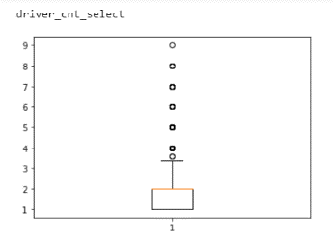
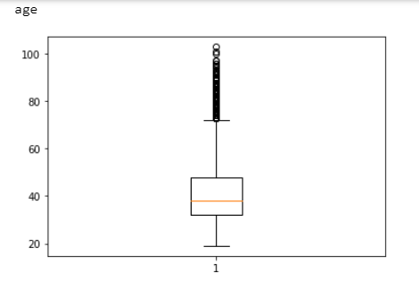
Methodology
b)Outliers:
(A) : Vehicle_cnt_select Boxplot
(B) : Driver_cnt_select Boxplot
(C) : Age Boxplot
outliers = ["age", "annual_premium_select", "driver_cnt_select", "vehicle_cnt_select"]
for col in outliers:
out_age = data_X_train[col].quantile(0.75)+1.5*iqr(data_X_train[col])
data_X_train[col]=data_X_train[col].mask(data_X_train[col]>out_age,out_age)

Slide 15
Methodology
c)Categorical Variable treatment:
Carrying Exploratory data analysis or Model building on categorical variables is next to impossible due to its mathematics. So, the categorical variables in the data have to be treated by certain methods and should be converted into numerical values. Most used are Label Encoding and Dummy Coding.
variable | Categorical Treatment
'division' | Dummy Encoding
'region' | Dummy Encoding
'Cancel_reason_bucket' | Dummy Encoding
'Pif_own_rent_cd' | Dummy Encoding
'Internet_sale_ind' | Dummy Encoding
'Pif_risk_lvl' | Dummy Encoding
treatment' | Label Encoding
channel_cd' | Label Encoding
state' | Dummy Encoding

Slide 16
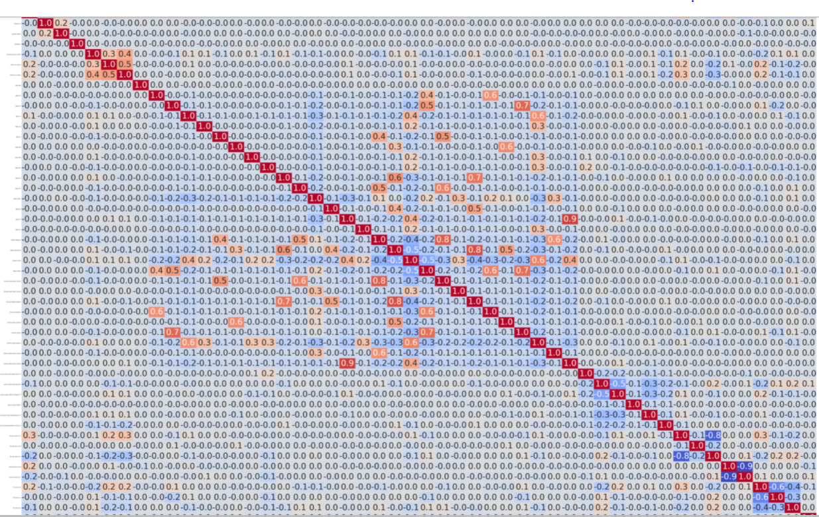
Methodology
d) Feature Engineering:
i. Variability in the data:
- unique_key
- zip5
ii. Multicollinearity:
- State_TX & Division_West_South_Central ,
- Region_Midwest & Division_Middle_Atlantic,
- Region_Northeast & Division_East_North_Central.

Slide 17
Methodology
Algorithm:
Goal : To separate those who are likely to respond vs those who are less likely to respond to a promotion.
A,C and F,G are the Sure Thing! B,H are the Persuadables.
Approach:
1. Mark A/B/C as 1 and the rest (D to J) as 0. Up-sample the training data.
2. Train the model on the entire dataset. If the model identify 1 then send promo, if 0 we do not send promo
Reason why it works:
- With the old response model, normally we will build it based on all responders (A,B, C, F, G), which means B is only 20% of the responders. With the new approach, we only identify A, B, C as responders, now B accounts for 33% of the responders, meaning that the model is more likely to capture B&H in the validation dataset.
 | Audience
Treat | A | B | C | D | E
Control | F | G | H | I | J
* Highlight in green means that the customer responded

Slide 18
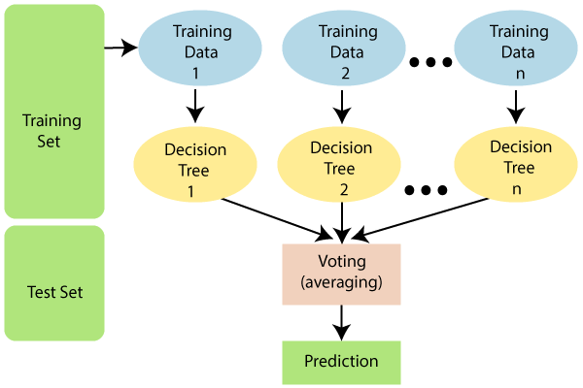
Methodology
Random Forest:
Measure | Train data | Test data
Accuracy | 100% | 78%
Recall | 100% | 4.6%
AUC Score | 100% | 50.8%
The above model performs well on the training data, but it fails to perform well on the test data set. So we consider these types of cases as overfitting. We have to perform hyperparameter tuning on the model.

Slide 19
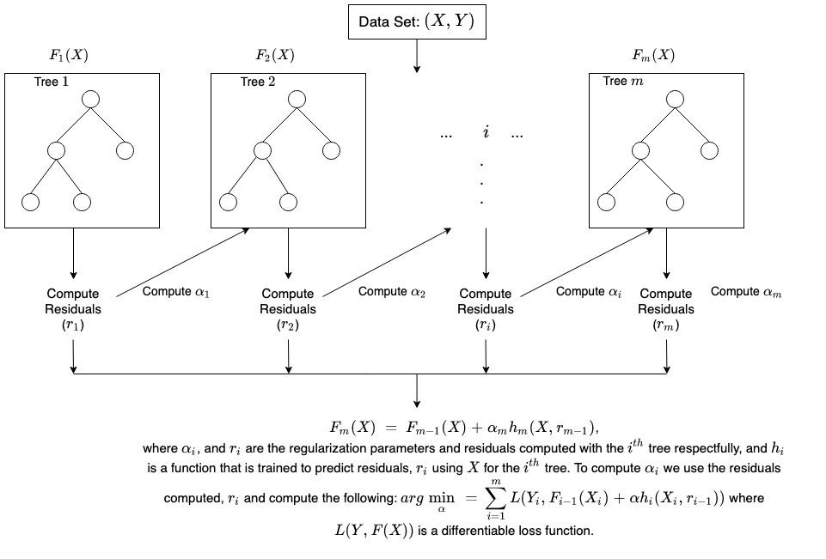
Methodology
Xg Boost:
Measure | Train data | Test data
Accuracy | 100% | 82%
Recall | 100% | 9.6%
AUC Score | 100% | 52.03%
There has been a slight increase in the evaluation metrics. We will be performing hyperparameter tuning on the model to elevate the outcomes more .

Slide 20
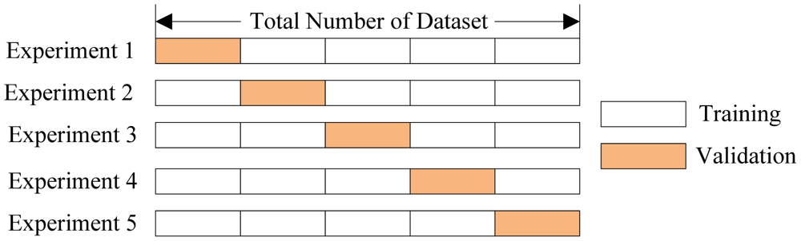
Methodology
XGBoost with Gradient Search CV
It is similar to grid search in random forest, here we perform a series of steps updating each parameter at a particular step.
For hyperparameter tuning, we run many rounds of the entire K-Fold CV process, each time with different model parameters.
We compare all of the models, choose the best, train it on the whole training set, then put it through its paces on the testing set.

Slide 21
Methodology
Here we provided a table of parameter update at each step.
­ | Train accuracy | Test accuracy | train recall | test recall | train auc | test auc | update
XG_basic | 91.21 | 82.32 | 90.9 | 9.6 | 91.21 | 52.03 | -
xg_fea_grid_step1 | 91.64 | 82.99 | 92.04 | 10.42 | 91.64 | 52.33 | -
xg_fea_grid_step2 | 90.87 | 81.47 | 91.29 | 10.98 | 90.84 | 52.78 | max_deapth=2, min_child_weight=0
xg_fea_grid_step3 | 85.89 | 79.31 | 85.41 | 11.51 | 85.62 | 53.27 | gamma=0
xg_fea_grid_step4 | 85.6 | 77.62 | 85.7 | 12.66 | 85.41 | 53.41 | colsample_bytree=0.75, subsample=0.7, reg_alpha=0.0001
xg_fea_grid_step5 | 85.6 | 77.31 | 85.7 | 12.86 | 85.41 | 54.01 | reg_lamba=0.05
xg_fea_grid_step6 | 100 | 77.14 | 100 | 13.69 | 100 | 55.72 | learning_rate=0.5, n_estimators=3000
There is an increase in the output values, but it is not up to the industrial standards

Slide 22
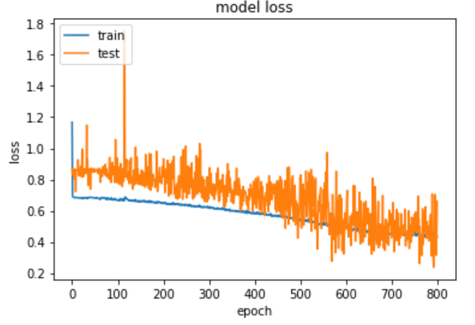
Methodology
Neural net
model.add(Dense(64, input_dim=46, activation='relu'))
model.add(Dense(32, activation='relu'))
model.add(Dropout(0.2))
model.add(Dense(16, activation='relu',kernel_regularizer=regularizers.l1_l2(l1=1e-5, l2=1e-4),bias_regularizer=regularizers.l2(1e-4),activity_regularizer=regularizers.l2(1e-5)))
model.add(Dense(16, activation='relu',kernel_regularizer=regularizers.l1_l2(l1=1e-5, l2=1e-4),bias_regularizer=regularizers.l2(1e-4),activity_regularizer=regularizers.l2(1e-5)))
model.add(Dropout(0.2))
model.add(Dense(8, activation='relu',kernel_regularizer=regularizers.l1_l2(l1=1e-5, l2=1e-4),bias_regularizer=regularizers.l2(1e-4),activity_regularizer=regularizers.l2(1e-5)))
model.add(Dense(4, activation='relu',kernel_regularizer=regularizers.l1_l2(l1=1e-5, l2=1e-4),bias_regularizer=regularizers.l2(1e-4),activity_regularizer=regularizers.l2(1e-5)))
model.add(Dense(1, activation='sigmoid'))
Measure | Train data | Test data
AUC Score | 87.25% | 59.1%
Loss | 49.75% | 53.6%

Slide 23
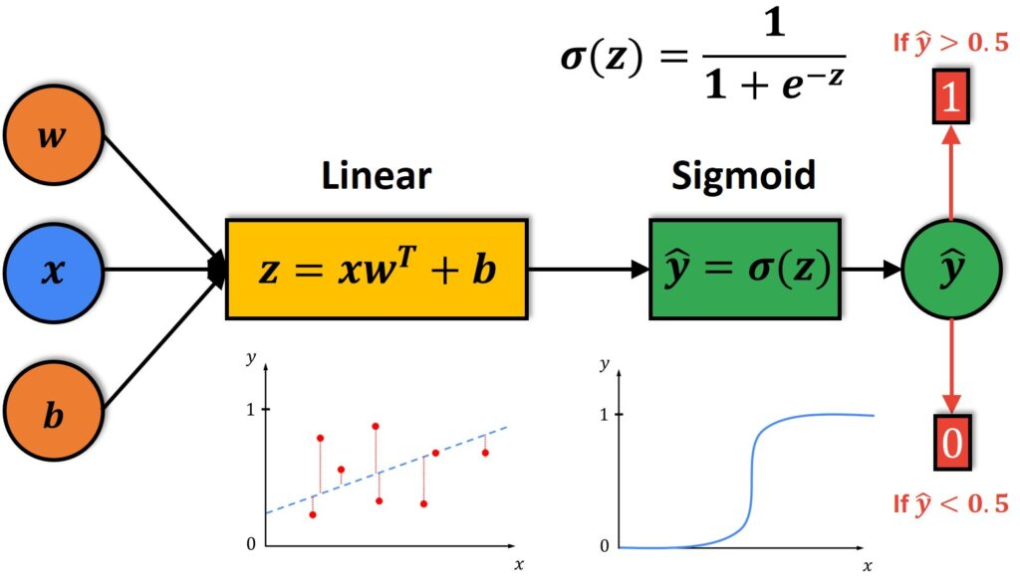
Methodology
Logistic regression
Measure | Train data | Test data
Accuracy | 59.53% | 55.17%
Recall | 64.07% | 58.19%
AUC Score | 59.01% | 56.29%
Surprisingly, the logistic regression has performed way lot different than all the other.
The model is facing a problem of underfitting
The reasons are a)Lesser records b)Poor optimisation

Slide 24
Methodology
Stacking Classifier
An ensemble learning technique where the predictions of multiple classifiers (referred to as level-one classifiers) are used as new features to train a Level-two classifiers.
Their predictions get stacked and are used as features to train the meta-classifier which makes the final prediction.
Level-1 Models (Base-Models): Models fit on the training data and whose predictions are compiled.
Level-2 Model (Meta-Model): Model that learns how to best combine the predictions of the base models.

Slide 25
Methodology
The level one classifiers are random forest and logistic regression.
The meta classifier is the XG Bosst algorithm which neutralizes the effect of both underfitting and overfitting
Measure | Train data | Test data
Accuracy | 91.57% | 83.14%
Recall | 89.07% | 48.19%
AUC Score | 85.17% | 71.98%
We were able to achieve an AUC>70 which is an industrial standard for the acceptance of the Model.

Slide 26
Results
Table 5.1: Stacking Classifier
Quantile Rank | Total |  |  | Promo |  |  | HO |  |  | IRR | Lift
 | count | resp | RR | count | resp | RR | count | resp | RR
1 | 399 | 17 | 0.042607 | 199 | 11 | 0.055276 | 199 | 6 | 0.030151 | 2.512563 | 183.3333
2 | 398 | 11 | 0.027638 | 199 | 8 | 0.040201 | 198 | 3 | 0.015152 | 2.504949 | 265.3266
3 | 398 | 19 | 0.047739 | 199 | 12 | 0.060302 | 200 | 7 | 0.035 | 2.530151 | 172.29
4 | 398 | 67 | 0.168342 | 199 | 33 | 0.165829 | 199 | 32 | 0.160804 | 0.502513 | 103.125
5 | 399 | 136 | 0.340852 | 200 | 69 | 0.345 | 200 | 69 | 0.345 | 0 | 100
The probability of outcomes have been measured and arranged in decending order along five quantiles.
Quantile one has a lift of 183, and quantile 5 has a lift of 100, which is with the least, and the quantiles show a decreasing trend with the second quantile has the highest Lift.
This model that has been built will be used in the third quarter by the onboarded team.

Slide 27
Conclusion
The general conclusion is that each model required several trials for all data sets in order to capture the model parameters that gave the best model results.
Uplift modeling to obtain models that make it possible to comprehend how to target only a subgroup of the entire customer base instead of targeting the whole customer base with campaign offers, given the data related to the different campaigns in this project.
By doing this, the retail company receives an incremental gain and targets the customers of respective top quantiles according to the budget of the campaign.

Slide 28
References
[1]Jiliang Tang Salem Alelyani, Huan Liu. “Feature Selection for Classification: A Review." In: Arizona state university 2014 (Jan. 2014), p. 1.
[2]Hastie, Trevor, Tibshirani, Robert, and Friedman, Jerome. The Elements of Statistical Learning. Data Mining, Inference, and Prediction. 2nd ed. Springer Series in Statistics. Springer, 2008.
[3]Montgomery, Douglas C., Peck, Elizabeth A., and Vining, G. Geoffrey. Introduction to Linear Regression Analysis. Fifth Edition. Wiley Series in Probability and Statistics. Wiley, 2012.
[4]https://www.steveklosterman.com/uplift-modeling/
[5]Rzepakowski, Piotr and Jaroszewicz, Szymon. "Uplift modeling in direct marketing." In: Journal of Telecommunications and Information Technology 2012 (Jan. 2012), pp. 43–50
[6]Guelman, Leo. "uplift: Uplift Modeling." In: (2014). URL: https://CRAN.R-project.org/package=uplift.
[7] Liaw, Andy and Wiener, Matthew. "Classification and Regression by randomForest." In: R News 2.3 (2002), pp. 18–22. URL: https://CRAN.R-project.org/doc/Rnews/.
[8] https://www.kaggle.com/btyuhas/bayesian-optimization-with-xgboost
[9] https://www.kaggle.com/huntermcgushion/bayesian-hyperparameter-optimization-and-xgboost
[10] https://aiinpractice.com/xgboost-hyperparameter-tuning-with-bayesian-optimization/

Slide 29
Thank you

